Slide 1
E-Commerce Basics
Simple Overview for Students

Slide 2

01
Introduction to E-Commerce

Slide 3

Introduction
E-commerce involves buying and selling products or services online. It has transformed how businesses and customers interact, making transactions faster and easier. This presentation will explore the fundamental concepts and types of e-commerce, helping students understand its role in the modern world.

Slide 4
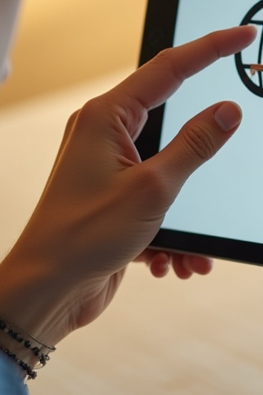
Definition and basic concept
E-commerce, or electronic commerce, is the process of conducting business transactions over the internet. It allows consumers to shop from anywhere, anytime, without physical stores. Key elements include online shopping carts, payment gateways, and secure data exchange. This innovation simplifies purchases for both businesses and customers.

Slide 5
Types of e-commerce
There are several types of e-commerce, including B2C (business to consumer), B2B (business to business), C2C (consumer to consumer), and C2B (consumer to business). Each type serves different markets and needs, making e-commerce a versatile and growing sector in global trade.

Slide 6
Importance in today’s world
E-commerce plays a crucial role in today’s economy by enabling global trade and 24/7 accessibility. It offers convenience to consumers and expands market reach for businesses. With technological advancements, e-commerce promotes faster transactions, reduces costs, and supports diverse industries, making it a key driver of economic growth and innovation worldwide.

Slide 7

02
Project Overview

Slide 8
Code used in the program:
HTML : HTML (Hypertext Markup Language) is the standard markup language for creating web pages and web applications. It provides the basic structure of a webpage, which is then enhanced and modified by CSS and JavaScript. Used for Creating the skeleton/content of web pages and Creates interactive forms for user input
CSS: CSS is a stylesheet language used to describe the presentation and styling of HTML documents. It controls how web pages look, including layout, colors, fonts, and responsive design. Used for Colors, fonts, spacing, borders and Making websites work on all devices
JAVASCRIPT: JavaScript is a versatile, high-level programming language primarily used for creating interactive and dynamic web content. It's one of the core technologies of the World Wide Web, alongside HTML and CSS. used for Dynamically changing HTML/CSS and Real-time input checking

Slide 9
Objectives of the project
The project aims to develop a user-friendly e-commerce website that simplifies online shopping. Key objectives include enhancing accessibility, improving user experience, and integrating secure payment options. Additionally, it seeks to demonstrate the application of web technologies and database management in real-world business scenarios.

Slide 10
System overview and purpose
This system is designed to facilitate online buying and selling through a streamlined website. It combines front-end interfaces for seamless user interaction with back-end processes that handle inventory, orders, and payments. The purpose is to create a reliable platform that supports efficient and secure e-commerce transactions.

Slide 11

Expected outcomes and benefits
Expected outcomes include a fully functional website with core e-commerce features like product browsing, secure checkout, and order tracking. Benefits encompass improved customer satisfaction, increased sales opportunities, and practical experience in web development. This project also highlights the value of e-commerce in modern business practices.

Slide 12
Conclusions
This project successfully illustrates the fundamentals and impact of e-commerce in today’s digital landscape. It emphasizes the benefits of online shopping platforms for both users and businesses while identifying future enhancements. Overall, the system enhances understanding of technological integration in commerce and its growing importance globally.

